Slide 1
DELE CA2 Part A
Ethan Tan (2012085)
DAAA/2B/03

Slide 2
Background Research – CIFAR-10 Dataset
CIFAR-10 is a dataset which comprises 60,000 32x32 coloured images in 10 classes/categories, with 6000 images per class. There are 50000 training images and 10000 test images in total (i.e. 5000 training and 1000 test images per class).
The classes are completely mutually exclusive. There is no overlap between automobiles and trucks. "Automobile" includes sedans, SUVs, things of that sort. "Truck" includes only big trucks. Neither includes pickup trucks.
This ensures that each class is isolated from the rest.
airplane
automobile
bird
cat
deer
dog
frog
horse
ship
truck

Slide 3
Background Research – GANs
Since this is an image generation problem, GANs come to mind. Specifically, non-style-transfer GANs (like CycleGAN/StyleGAN).
Therefore, some candidate GANs include vanilla DCGAN, Conditional DCGAN and WGAN.
All these GANs make use of some convolutional neural network (CNN) for both the generator and discriminator.
Conditional GAN takes an additional feature, which is the desire category of the image.
WGAN uses a specific loss function, known as the Wasserstein Loss function (W in WGAN).
I decided to start with DCGAN and then try out CDCGAN and WGAN if I had time. Unfortunately, I did not have time to try them out
I tried using DCGAN on the entire CIFAR-10 dataset at once. The results were completely unrecognizable.
Thus, I partitioned the dataset by class in hope of generating better quality images.

Slide 4
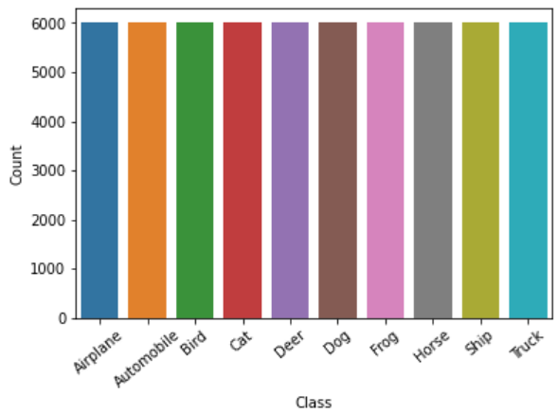
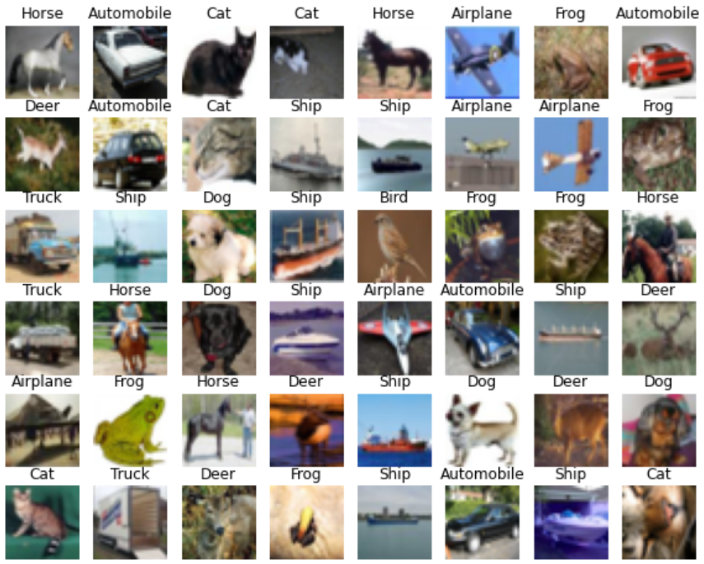
EDA
To begin, I conducted simple exploratory data analysis to ensure the data was indeed as it stated
The classes were balanced with 6000 images from each
The images were an assortment of cats, dogs, cars, etc.
They ranged from poor quality (absolutely weird) to clearly represented
This indicated that I had to perform some data cleaning prior to training the GAN models

Slide 5
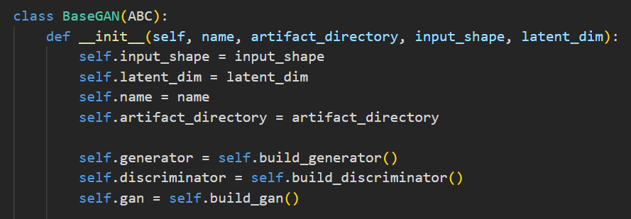
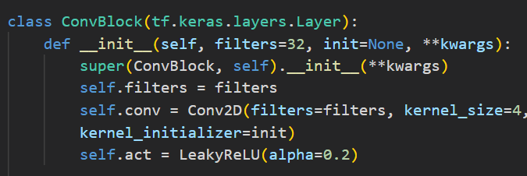
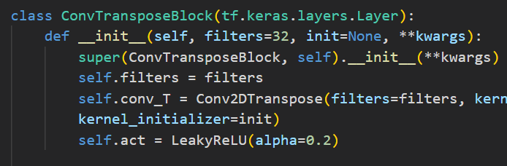
Defining GAN Components
First, I defined an abstract BaseGAN class which was supposed to support all 3 types of GANs (DCGAN, CDCGAN, WGAN)
I then created two custom layers by inheriting tensorflow.keras.layers.Layer
These custom classes simply encapsulated the layers that are reused often in the discriminator and generator respectively
The ConvBlock layer was used for downsampling and feature extraction in the discriminator
The ConvTransposeBlock layer was used for upsampling and feature generation in the generator
This architecture was inspired by VGG

Slide 6
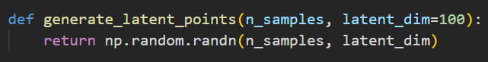
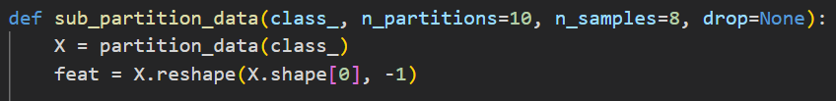
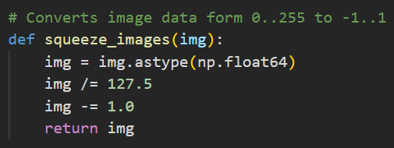
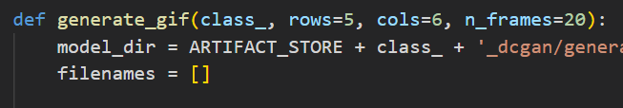
Defining GAN Components
Some other utility functions were also defined, such as:
Data partitioning functions
Image sharpening functions
Pixel value normalisation functions
Label smoothing function
Image/GIF generation functions

Slide 7
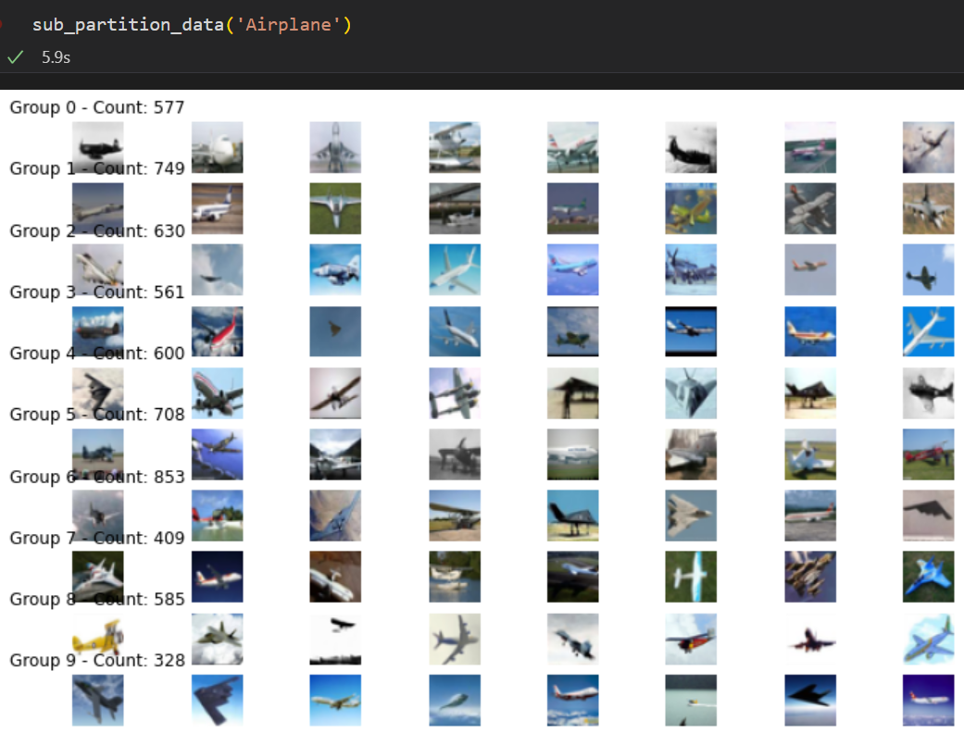
Gan Training – Image Selection
Before training any GAN models, I performed very simplistic image selection in an effort to keep only the best quality images for the GANs to learn from
That is the responsibility of the function sub_partition_data
Firstly, the images are flattened (32x32x3 > 3072)
Next, PCA was applied to the flattened images to reduce the feature space (n_components=10)
Next, K-means clustering algorithm was used to cluster “similar” images together
Finally, I would look at the clusters and see which ones were of acceptable quality

Slide 8
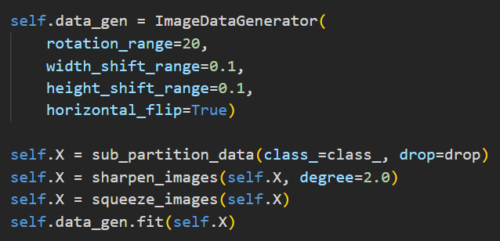
GAN Training – Feature Engineering
After performing image (sample) selection, each DCGAN was programmed to perform feature engineering before training the internal networks
First, data of the selected clusters from the specified class are loaded
They are then sharpened as the original quality of the images is quite low
The pixel values are then “squeezed” into the range [-1, 1]
Afterwards, the pre-processed images are fed into a data generator which randomly shifts, flips and rotates the images

Slide 9
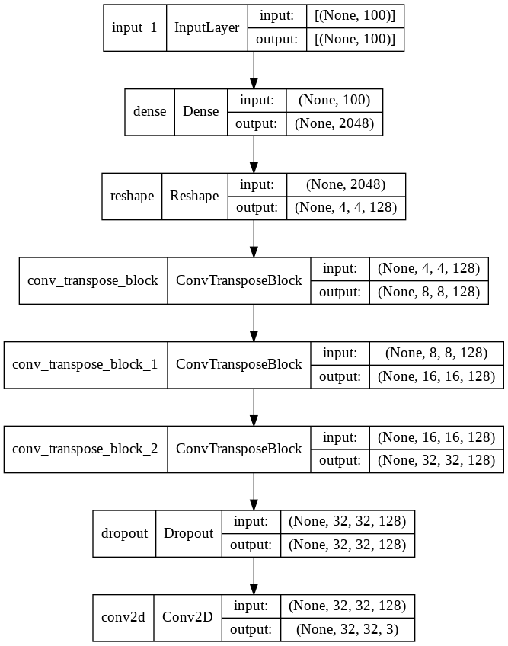
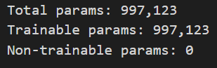
Gan Training – Generator Architecture
I checked the model architectures of the generator and discriminator to make sure they were sound
The generator takes in a random latent vector of shape (100,), followed by a dense layer of size 4x4x128 = 2048
The following layers upsample the data and generate features using ConvTransposeBlocks, with each doubling the dimensions (height and width) of the image (4x4 > 8x8 > 16x16 > 32x32)
One dropout layer (not really necessary) to reduce overfitting
Finally, a 2D convolutional layer which has 3 channels (RGB)
There are ~1, 000, 000 trainable parameters, which is not that much as the architecture is almost fully convolutional

Slide 10
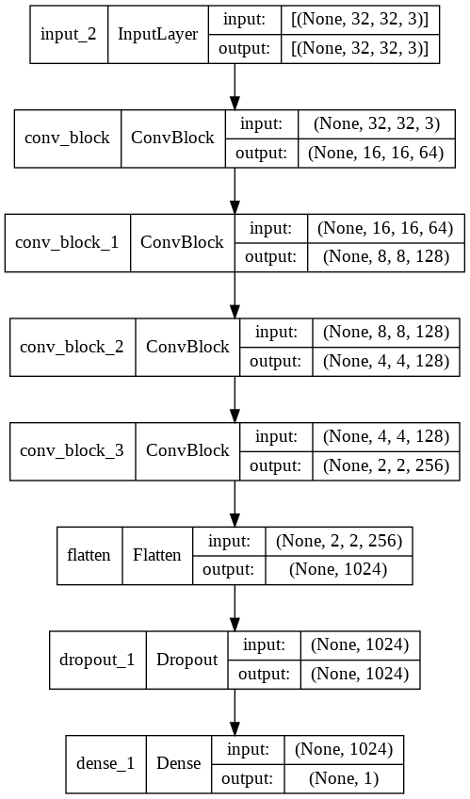
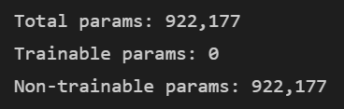
Gan Training – Discriminator Architecture
The discriminator takes in an image as input (32x32x3)
The following layers downsample the data and extract features using ConvBlocks, with each halving the dimensions (height and width) of the image (32x32 > 16x16 > 8x8 > 4x4 > 2x2)
A flatten layer to prepare the data for consolidation (prediction)
One dropout layer (not really necessary) to reduce overfitting
Finally, a dense layer with one neuron to predict the whether an image is real or fake
There are ~900, 000 trainable parameters, which is not that much as the architecture is almost fully convolutional
The parameters are labelled as non-trainable as the trainable flag was set to False after compilation to be combined with the generator

Slide 11
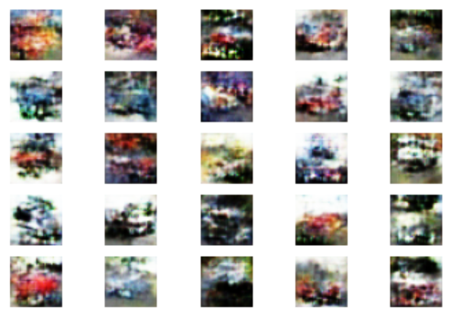
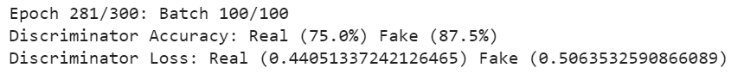
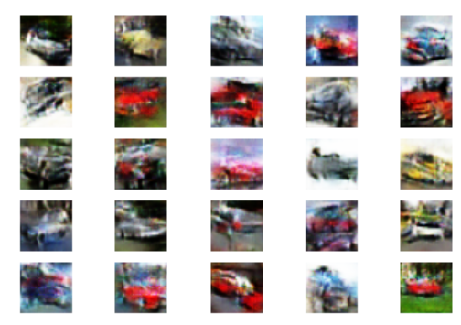
Gan Training – Model Tracking
The discriminator’s accuracy and loss for the real and fake images of each batch are printed at the end of each epoch
This is a good measure of balance when training the DCGAN
Ideally, the accuracy should be about 50% for both, if not they should be as similar as possible
The loss should also be roughly the same
Besides this numerical approach, images are generated periodically at each checkpoint
I checked the images to see if the images were getting better
Automobiles (20 epochs)
Automobiles (60 epochs)

Slide 12
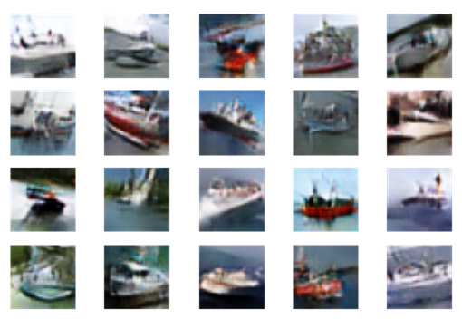
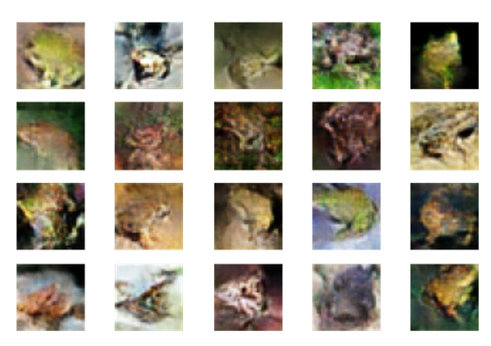
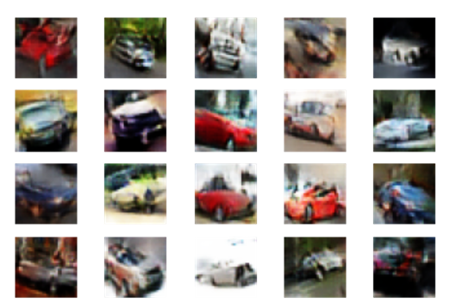
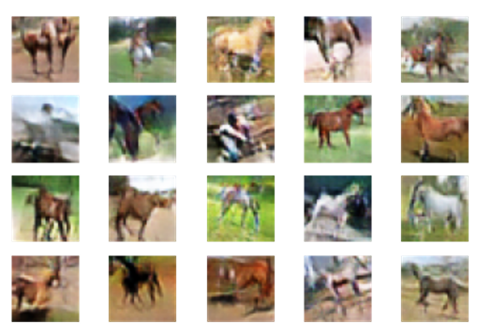
Gan Evaluation – Qualitative / Visual
Ships
Frogs
I analysed the images and see if they are resemble their actual counterparts
I also asked my family members if they could guess what kind of images they were
Most of the classes were vaguely similar but some were just indistinguishable (like cats and dogs)
The images are best viewed zoomed out as 32 x 32 pixel resolution is not very fantastic
My computer’s image software also tends to blur the images when zoomed in
Automobiles (Cars)
Horses

Slide 13
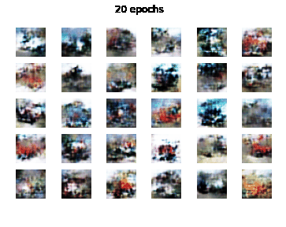
Gan Learning Process
I generated GIFs to animate the learning process of each DCGAN
The same set of random latent vectors was used at each stage so that the changes would converge
To the right is the GIF of the DCGAN tasked with generating truck images
The images slowly take the shapes and forms of trucks
Rather cool, huh?

Slide 14
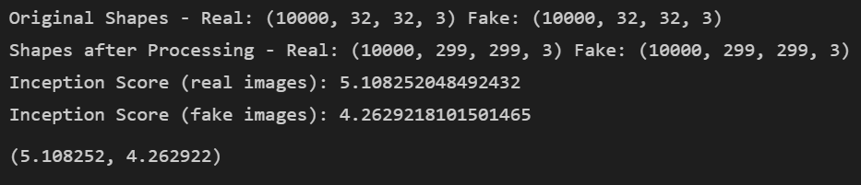
Gan Evaluation – Quantitative / Numeric
Inception score measures how distinguishable images are from one another
Therefore, a higher score would indicate diversity in the images while a lower score denotes that the images look similar
Calculating the inception score on real and fake images, the fake images obviously fared poorer to the real ones
Nevertheless, it is not too far away from the IS of the real images (not bad)
The inception score for real images is, surprisingly, less than 10. This is likely due to classes being similar to one another (Automobiles + Trucks / Deer + Horses)

Slide 15
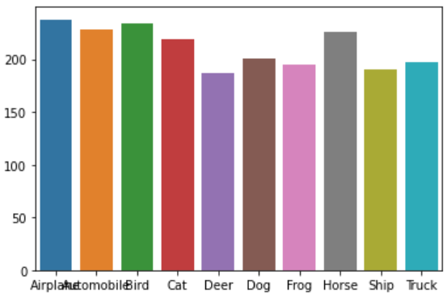
Gan Evaluation – Quantitative / Numeric
FID Scores
Fréchet Inception Distance measures how similar groups of images are to one another
It uses the statistics of the images (distributions and entropies) to determine whether images are similar or dissimilar
Hence, I compared the generated images against their real counterparts
The bar chart shows the respective FID scores for each of the 10 classes
There seems to be some variation with the mean about 200
200 is relatively average, considering random noise scores about ~350 and identical images score 0

Slide 16
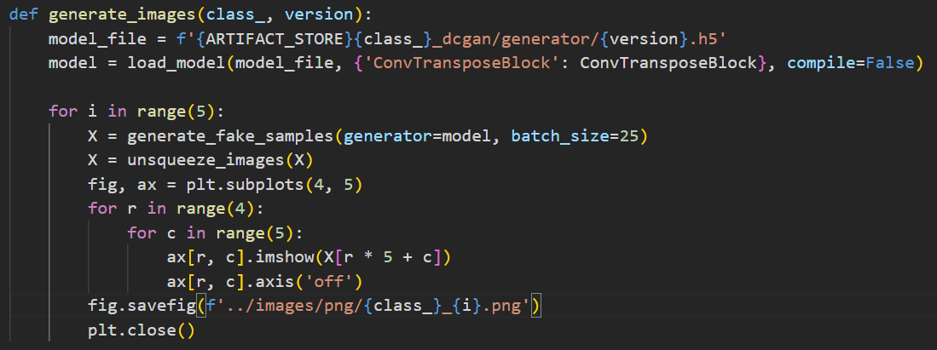
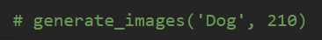
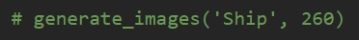
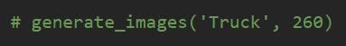
Image Generation
The generate_images function was used to generate the final batch of images
All I had to do was to specify the class and which version model to use
5 sets of 20 (4 rows and 5 columns) images were then generated and stored in the directory images/png
10 x 5 x 4 x 5 = 1000 small coloured images (100 from each category)

Slide 17
Conclusions
Image generation is no easy feat, by any means. (I’m not a great artist)
GANS are a really fascinating part of machine learning
They make us rethink what is possible using math and quite frankly,
opens us to new possibilities
Neural networks may be incorporated into our lives right under our very noses

Slide 18
References
https://machinelearningmastery.com/how-to-develop-a-generative-adversarial-network-for-a-cifar-10-small-object-photographs-from-scratch/
https://machinelearningmastery.com/how-to-implement-the-inception-score-from-scratch-for-evaluating-generated-images/
https://machinelearningmastery.com/how-to-implement-the-frechet-inception-distance-fid-from-scratch/
https://towardsdatascience.com/gan-ways-to-improve-gan-performance-acf37f9f59b
https://machinelearningmastery.com/how-to-train-stable-generative-adversarial-networks/

